Slide 1
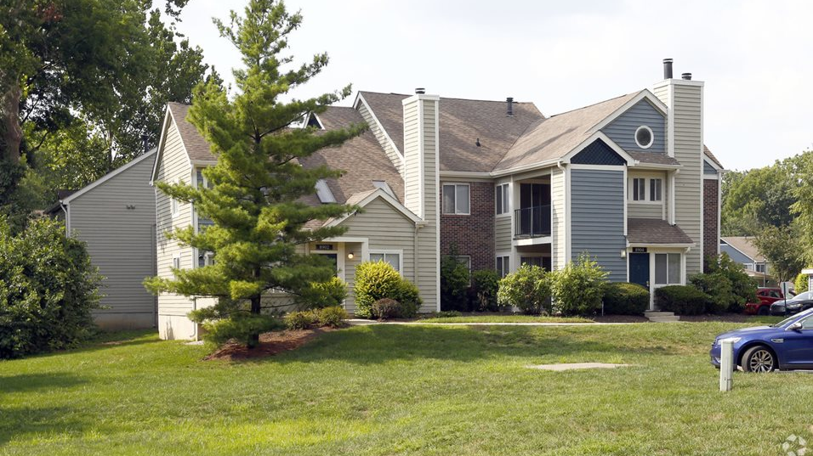
Riverbend Apartments
996 Units | Irreplaceable Suburban Location | Proximate to Class A Office & Retail | Lowest Rents in the Submarket
8850 Riverbend Parkway
Indianapolis, IN 46250

Slide 2
Confidentiality and Disclaimer
CONFIDENTIALITY AND DISCLAIMERS
THIS INFORMATION MEMORANDUM (“INFORMATION MEMORANDUM”) IS PROVIDED ON A CONFIDENTIAL BASIS FOR INFORMATIONAL PURPOSES ONLY IN CONNECTION WITH AN EVALUATION OF A POTENTIAL INVESTMENT (“INVESTMENT”) THAT MAY BE OFFERED BY RIVERBEND MANAGEMENT 11235 LLC OR ITS AFFILIATES (COLLECTIVELY, THE “COMPANY”) IN CONNECTION WITH ONE OR MORE COMPANY PROJECTS (“PROJECTS”). DISCLOSURE OF ANY OF THE INFORMATION CONTAINED IN THE INFORMATION MEMORANDUM, OTHER THAN TO YOUR LEGAL AND FINANCIAL ADVISORS, OR USE FOR ANY OTHER PURPOSE IS EXPRESSLY PROHIBITED WITHOUT THE PRIOR WRITTEN CONSENT OF THE COMPANY. THE INFORMATION MEMORANDUM MAY NOT BE REPRODUCED OR DISPLAYED, IN WHOLE OR IN PART, VIA ELECTRONIC TRANSMISSION OR OTHERWISE AND IT IS ACCEPTED WITH THE UNDERSTANDING THAT IT WILL BE RETURNED OR DESTROYED ON REQUEST IF AN OFFERING IS NOT INITIATED OR AN INVESTMENT IS NOT MADE.
THIS IS NOT AN OFFER TO SELL ANY SECURITIES OR THE SOLICITATION OF AN OFFER TO BUY ANY SECURITIES. OFFERS WILL BE MADE ONLY THROUGH DEFINITIVE OFFERING MATERIALS (“OFFERING MATERIALS”) PREPARED AND DELIVERED BY THE COMPANY WHICH WILL INCLUDE, WITHOUT LIMITATION, A SUBSCRIPTION AGREEMENT AND OTHER DEFINITIVE AGREEMENTS SETTING FORTH THE TERMS AND CONDITIONS OF THE OFFERING AND ANY SECURITIES OFFERED THEREBY.
OFFERS TO MAKE AN INVESTMENT WILL BE MADE ONLY TO “ACCREDITED INVESTORS,” AS THAT TERM IS DEFINED BY REGULATION D UNDER THE SECURITIES ACT OF 1933, AS AMENDED (THE “SECURITIES ACT”), AND THE RULES AND REGULATIONS THEREUNDER, WHO DIRECTLY OR THROUGH THEIR ADVISORS, HAVE THE KNOWLEDGE AND EXPERIENCE TO EVALUATE AN INVESTMENT AND THE INFORMATION CONCERNING THE COMPANY AND THE PROJECT.
NO PERSON HAS BEEN AUTHORIZED TO MAKE ANY REPRESENTATIONS CONCERNING THE COMPANY, THE PROJECT OR AN INVESTMENT. YOU SHOULD NOT RELY ON ANY UNAUTHORIZED STATEMENTS OR ANY OTHER INFORMATION OTHER THAN THAT CONTAINED IN THE OFFERING MATERIALS.
MARKET DATA AND INDUSTRY FORECASTS THAT MAY BE INCLUDED IN THE INFORMATION MEMORANDUM WERE OBTAINED FROM THE COMPANY’S INTERNAL ANALYSIS, MARKET RESEARCH, PUBLICLY AVAILABLE INFORMATION AND INDUSTRY PUBLICATIONS. SUCH INFORMATION HAS BEEN OBTAINED FROM SOURCES BELIEVED TO BE RELIABLE, BUT THAT THE ACCURACY AND COMPLETENESS OF SUCH INFORMATION IS NOT GUARANTEED. WHILE BELIEVED TO BE RELIABLE, THIS INFORMATION HAS NOT BEEN INDEPENDENTLY VERIFIED BY THE COMPANY AND THE COMPANY MAKES NO REPRESENTATION AS TO THE ACCURACY OF THIS INFORMATION.
Disclosure Regarding Forward-Looking Statements
THE INFORMATION MEMORANDUM CONTAINS CERTAIN FORWARD-LOOKING STATEMENTS WITH RESPECT TO THE COMPANY’S OR THE PROJECT’S PROSPECTS, BUSINESS, RESULTS OF OPERATIONS, CAPABILITIES AND LIQUIDITY EVENTS INCLUDING, WITHOUT LIMITATION, STATEMENTS CONCERNING ACQUISITION COSTS, IMPROVEMENT COSTS AND TIMING, FUTURE RENTS AND TIMING, DEMAND FOR THE PROJECT’S RENTAL UNITS, OTHER ANTICIPATED EXPENDITURES, THE NEED FOR ADDITIONAL FUNDS, PROJECT SALE PRICES AND TIMING AND OTHER EVENTS AND CIRCUMSTANCES DESCRIBED IN TERMS OF THE COMPANY’S EXPECTATIONS OR INTENTIONS. USE OF THE WORDS “ANTICIPATES,” “BELIEVES,” “ESTIMATES,” “EXPECTS,” “INTENDS,” “PROJECTS,” “PLANS,” “POTENTIALLY” AND SIMILAR EXPRESSIONS CONTAINED HEREIN ARE INTENDED TO IDENTIFY FORWARD-LOOKING STATEMENTS. SUCH FORWARD-LOOKING STATEMENTS INVOLVE KNOWN AND UNKNOWN RISKS, UNCERTAINTIES AND OTHER FACTORS THAT MAY CAUSE THE COMPANY’S OR THE PROJECT’S ACTUAL RESULTS, PERFORMANCE OR ACHIEVEMENT TO BE MATERIALLY AND ADVERSELY DIFFERENT FROM THOSE EXPRESSED OR IMPLIED BY SUCH FORWARD-LOOKING STATEMENTS. SUCH FACTORS INCLUDE, BUT ARE NOT LIMITED TO, RISKS RELATED TO THE REAL ESTATE TO BE ACQUIRED, UNKNOWN CONDITIONS, REGULATORY RISKS, RISKS IN GENERAL AND LOCAL ECONOMIC CONDITIONS, COMPETITION, CHANGES IN TENANT PREFERENCES AND DEMAND, DEMOGRAPHIC CHANGES, NATURAL DISASTERS, MARKET CONDITIONS FOR LOANS AND INVESTMENTS IN PROJECTS AND OTHER RISKS COMMONLY ASSOCIATED WITH MULTI-FAMILY REAL ESTATE OWNERSHIP. ALL OF THESE FORWARD-LOOKING STATEMENTS ARE BASED ON ESTIMATES AND ASSUMPTIONS MADE BY THE COMPANY WHICH, ALTHOUGH BELIEVED TO BE REASONABLE, ARE INHERENTLY UNCERTAIN. THEREFORE, NO ASSURANCE OR WARRANTY CAN BE GIVEN THAT ANY OF SUCH ESTIMATES OR STATEMENTS WILL BE REALIZED, AND ACTUAL RESULTS MAY DIFFER MATERIALLY AND ADVERSELY FROM THOSE CONTEMPLATED BY SUCH FORWARD-LOOKING STATEMENTS.
THE INFORMATION MEMORANDUM HEREIN IS AS OF THE DATE HEREOF. THE COMPANY HAS NO DUTY TO UPDATE THE INFORMATION MEMORANDUM AND DOES NOT INTEND TO UPDATE THE INFORMATION MEMORANDUM EXCEPT THROUGH THE OFFERING MATERIALS.
THIS IS NOT AN OFFER TO SELL ANY SECURITIES OR THE SOLICITATION OF AN OFFER TO BUY ANY SECURITIES. OFFERS WILL BE MADE ONLY THROUGH DEFINITIVE OFFERING MATERIALS (“OFFERING MATERIALS”) PREPARED AND DELIVERED BY THE COMPANY WHICH WILL INCLUDE, WITHOUT LIMITATION, A SUBSCRIPTION AGREEMENT AND OTHER DEFINITIVE AGREEMENTS SETTING FORTH THE TERMS AND CONDITIONS OF THE OFFERING AND ANY SECURITIES OFFERED THEREBY.
Projections contained herein are based upon numerous assumptions concerning facts over which the Company may have no control, including, without limitation: (a) interest rates; (b) occupancy rates; (c) the accuracy of projected expenses, including debt service; (d) rental rates and terms for new tenants, (e) the costs of future tenant and capital improvements and (f) the timing and future purchase prices for the project. Any negative deviation from one or more of these assumptions will have a material adverse effect on the projections. The Company believes such assumptions to be reasonable. However, these assumptions involve significant elements of subjective judgment and analysis, and no representation can be made as to their attainability. The selection of assumptions underlying such projected information required the exercise of judgment, and often, educated guesses about future events, and the projections are subject to uncertainty due to the effects that economic, legislative, regulatory, political or other changes may have on future events. Minor changes in the facts or circumstances underlying such assumptions could materially adversely affect the projections. To the extent that assumed events do not materialize, including, but not limited to, assumptions with respect to rental increases, improvement costs, and timing and purchase prices for a project sale, actual results may vary substantially from the projected results. As a result, there can be no assurance that the Company will achieve, or come close to achieving, the results set forth in the projections.

Slide 3
COVID-19 Disclaimer
DISCLAIMERS
CORONAVIRUS (COVID-19): THE CORONAVIRUS (COVID-19) (“CV”) SITUATION HAS CREATED PANIC IN THE TRAVEL, HOSPITALITY, HEALTH AND MOST RECENTLY, THE FINANCIAL MARKETS. AT THIS POINT, IT IS TOO EARLY TO DETERMINE HOW LONG AND HOW DEEP THE IMPACTS TO THE ECONOMY AND SPECIFICALLY THE REAL ESTATE INDUSTRY WILL BE. IN THE REAL ESTATE INDUSTRY, IT COULD MEAN THAT TENANTS MAY BE UNABLE TO PAY RENT AND HIGHER VACANCY RATES MUCH LIKE WHAT HAPPENED IN THE 2008 RECESSION. ADDITIONALLY POSSIBLE NEW EVICTION RESTRICTIONS, AND RENT FREEZES COULD ADVERSELY IMPACT THE SUCCESS OF THIS PROPOSED BUSINESS PLAN. ON MARCH 19, 2020 GOVERNOR ERIC HOLCOMB HAS ISSUED A MORATORIUM BANNING EVICTIONS AND STARTING COURT PROCEEDINGS THAT WOULD REMOVE DELINQUENT TENANTS. THIS MORATORIUM ON EVICTIONS HAS BEEN EXTENDED TO JUNE. WHILE THESE RESTRICTIONS APPEAR TO BE TEMPORARY, THE STATE OF INDIANA COULD EXTEND THEM AND/OR IMPLEMENT ADDITIONAL RESTRICTIONS THAT ADVERSELY IMPACT THE PROJECT. THE SPONSOR INTENDS TO COMMUNICATE WITH ITS TENANTS AND CLOSELY MONITOR RENTS AND SUITABLE TENANTS FOR THE PROJECT TO MITIGATE LOSSES.
ECONOMIC RISKS: THE ECONOMIC SUCCESS OF AN INVESTMENT IN THE PROJECT WILL DEPEND UPON THE RESULTS OF OPERATIONS, WHICH WILL BE SUBJECT TO THOSE RISKS TYPICALLY ASSOCIATED WITH INVESTMENTS IN REAL ESTATE. FLUCTUATIONS IN VACANCY RATES, RENT SCHEDULES, MARKET RENTAL RATES AND OPERATING EXPENSES CAN ADVERSELY AFFECT OPERATING RESULTS OR RENDER THE SALE OR REFINANCING OF THE PROJECT DIFFICULT OR UNATTRACTIVE. NO ASSURANCE CAN BE GIVEN THAT CERTAIN ASSUMPTIONS AS TO THE FUTURE LEVELS OF OCCUPANCY OF THE PROJECT, COST OF CAPITAL IMPROVEMENTS OR FUTURE COSTS OF OPERATING THE PROJECT WILL BE ACCURATE SINCE SUCH MATTERS WILL DEPEND ON EVENTS AND FACTORS BEYOND THE CONTROL OF THE SPONSOR. SUCH FACTORS INCLUDE CONTINUED VALIDITY AND ENFORCEABILITY OF THE LEASES, VACANCY RATES FOR PROPERTIES SIMILAR TO THE PROJECT, FINANCIAL RESOURCES OF TENANTS AND RENT LEVELS NEAR THE PROJECT, ADVERSE CHANGES IN LOCAL POPULATION TRENDS, MARKET CONDITIONS, NEIGHBORHOOD VALUES, LOCAL ECONOMIC AND SOCIAL CONDITIONS, SUPPLY AND DEMAND FOR PROPERTY SUCH AS THE PROJECT, COMPETITION FROM SIMILAR PROPERTIES, INTEREST RATES, REAL ESTATE TAX RATES, GOVERNMENTAL RULES, REGULATIONS AND FISCAL POLICIES, THE ENACTMENT OF UNFAVORABLE REAL ESTATE, RENT CONTROL, ENVIRONMENTAL, ZONING OR HAZARDOUS MATERIAL LAWS, UNINSURED LOSSES, EFFECTS OF INFLATION, AND OTHER RISKS
THE OPERATING PROJECTIONS PROVIDED TO INVESTORS HAVE BEEN REVISED TO FACTOR IN THE ADDED ECONOMIC RISK FACTORS THAT HAVE BEEN INTRODUCED BY THE COVID-19 SHUTDOWNS. THE SPONSOR HAS INCREASED YEAR 1 VACANCY LOSS TO 7.5% AND ADJUSTED THE YEARS AFTERWARDS TO REFLECT AN ANNUAL AVERAGE VACANCY LOSS OF 10.9%. FURTHERMORE, THE SPONSOR INCREASED BAD DEBT TO 6.9% IN YEAR 1 (4% ANNUALLY OVER THE INVESTMENT HORIZON)

Slide 4
Executive Summary
7
Investment Overview
8
Asset Overview
14
About Management
18

Slide 5
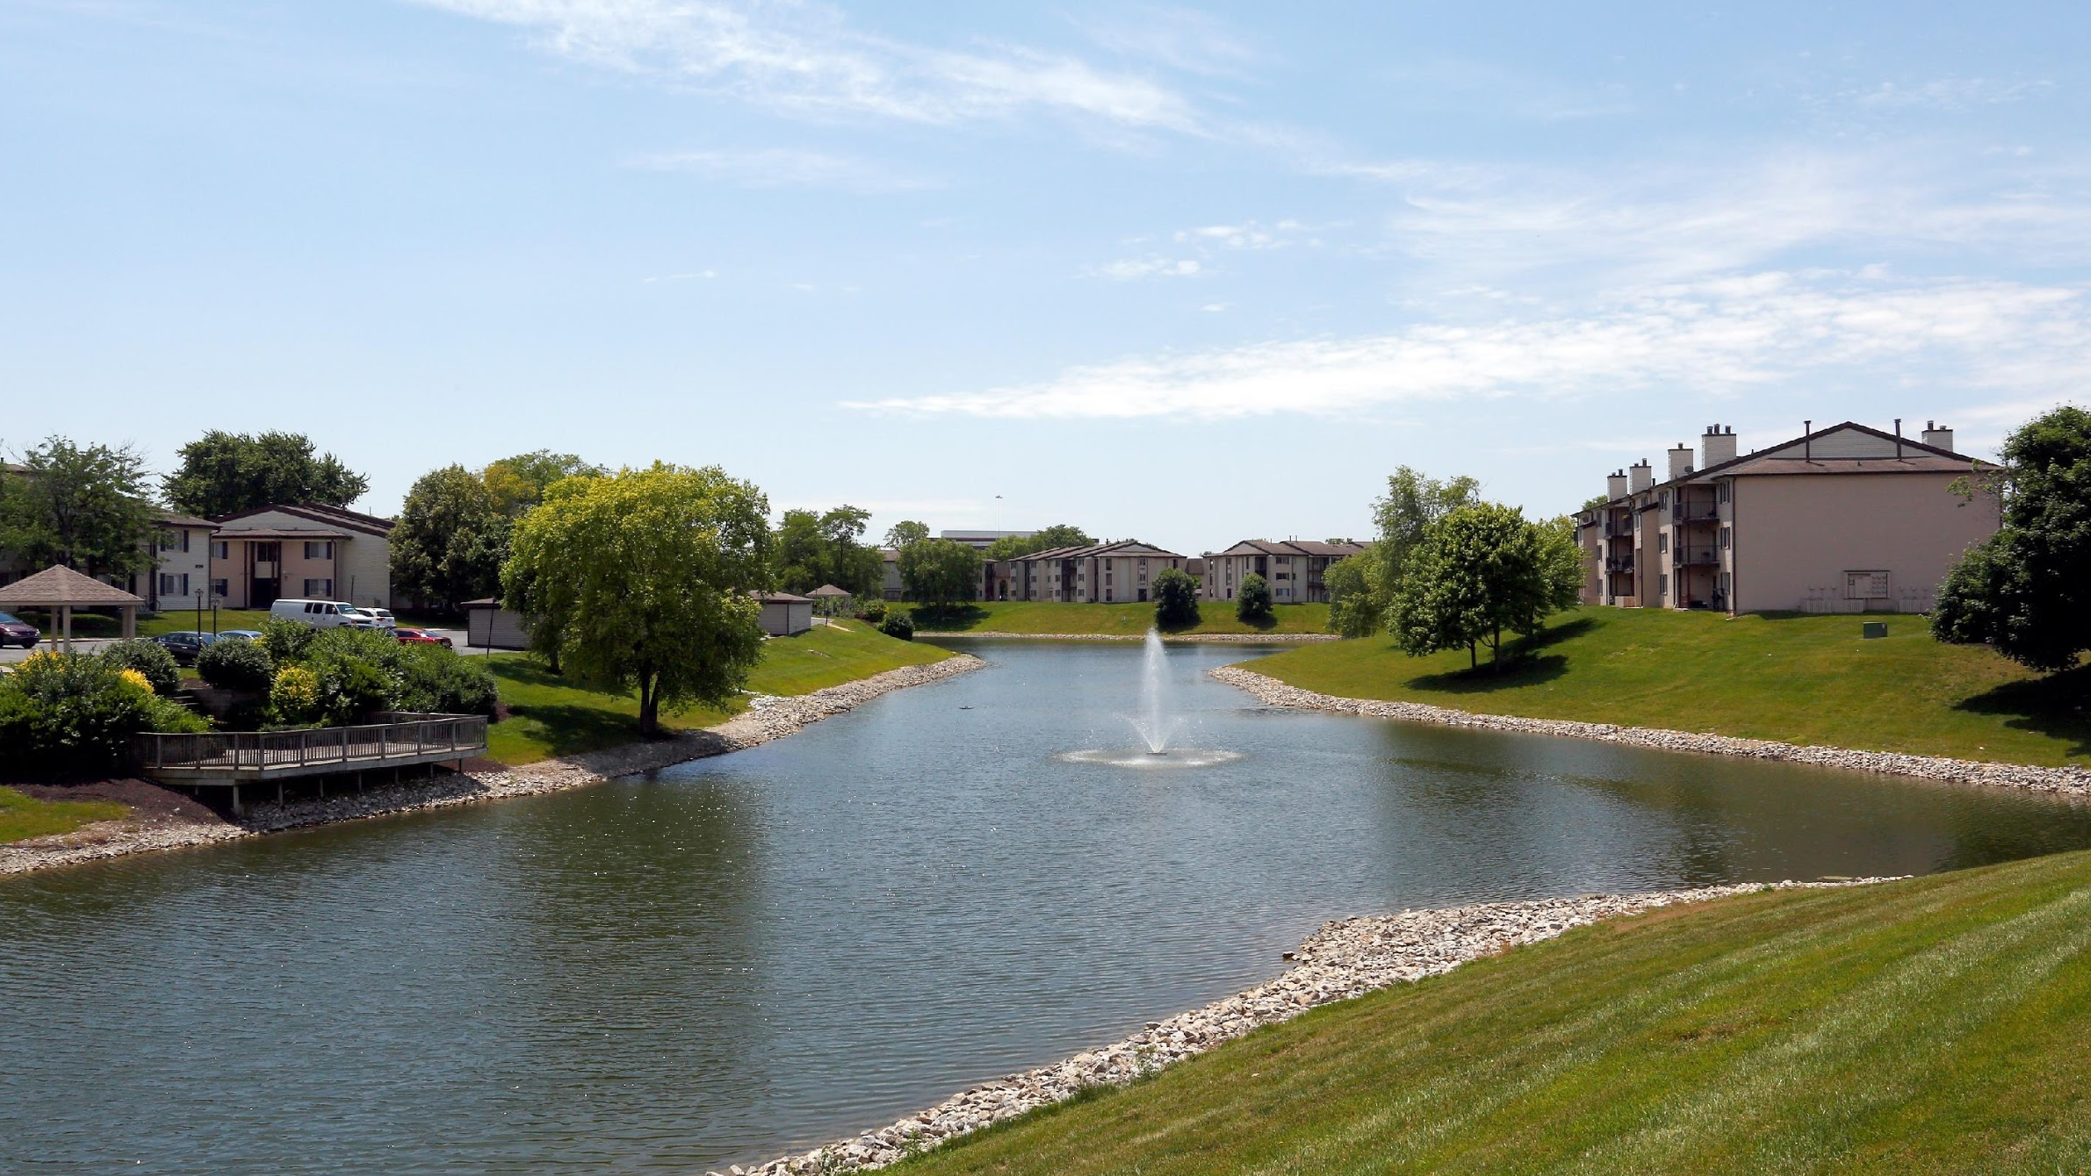
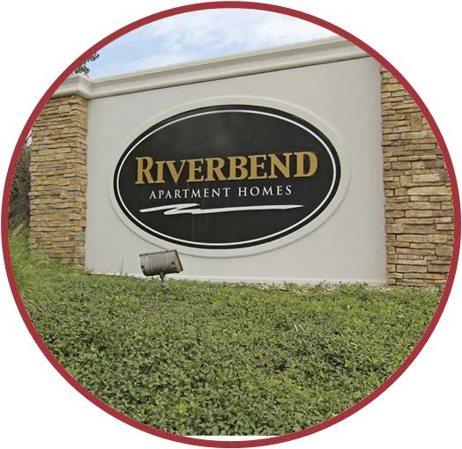
Magnified Depreciation Benefits
Scale in Indianapolis MSA
Irreplaceable Location
Experienced Sponsor
Riverbend
Indianapolis, IN
Attractive
Investment
Basis
Cash Flows During Renovation
Multiple Exit Strategies
Inefficiently Managed by TIC
Rent Comparables

Slide 6
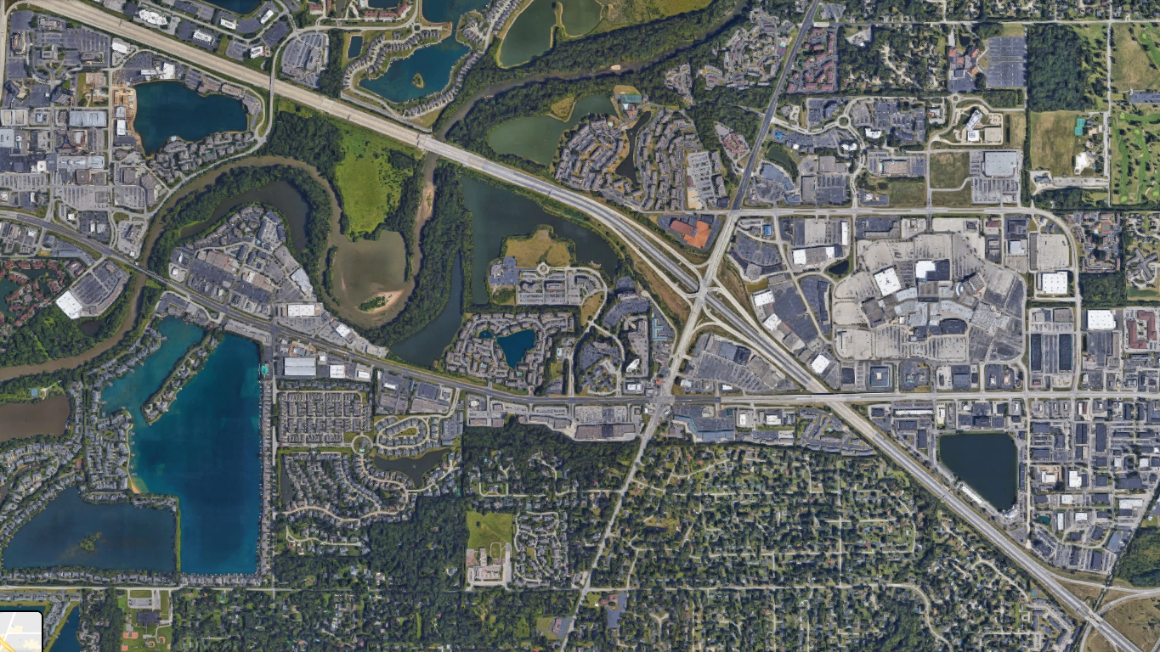
River Road Apartments
TGM Autumn Woods Apartments
Castle Creek Apartments
Class A Office Space
Riverbend
Lakeshore Apartments
Residential Properties $300K+
Class A Office Space

Slide 7
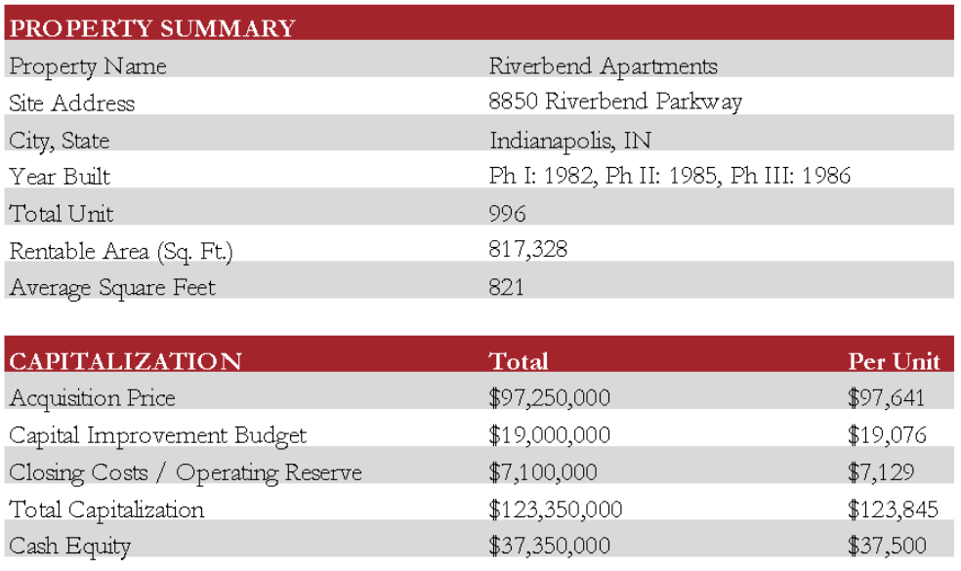
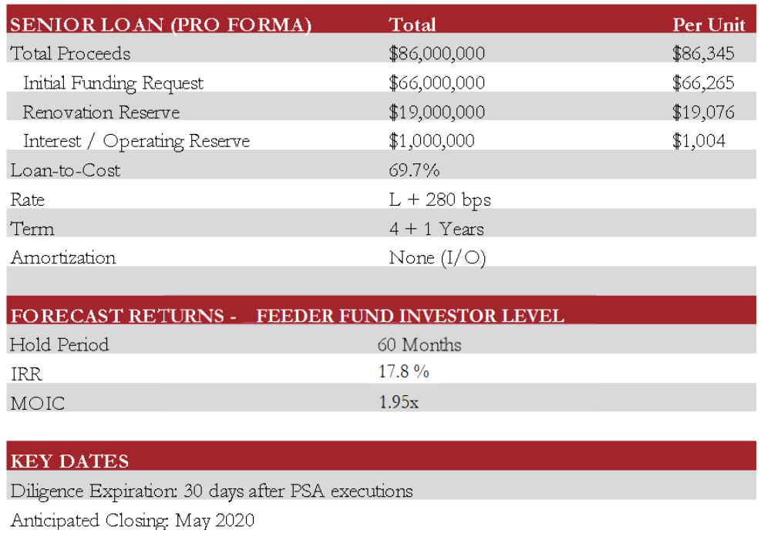
Executive Summary
Riverbendinvestments11235.com
Pepper Pike Acquisition Associates, LLC (the “Sponsor”) is under contract to acquire Riverbend Apartments (the “Property”), a 996-unit value-add multifamily apartment community located in Indianapolis, IN. The Property is located 0.3 miles from the city’s “Magnificent Mile” – the dynamic north side corridor that includes the finest and most dense collection of amenities in the state, including high-end retailers such as Apple, Armani, Crate & Barrel, Louis Vuitton, Nordstrom, Saks, Tesla, Tiffany & Co, and West Elm, among others. The Property lies between two of the region’s premier and largest retail destinations, The Fashion Mall at Keystone and Castleton Square Mall, and near Indianapolis’ premiere retail and dining destinations. Riverbend lies just over one mile from Keystone at the Crossing, one of Indianapolis’ most prestigious business addresses. The area is home to nearly 5,000 medical jobs in two nearby hospitals and dozens of medical office buildings. The location offers superior access to the region’s best employment, shopping, and dining and is a premier value-add reposition candidate.
Built in phases between 1982 and 1986, the Property was acquired by the current owners (a Tenant In Common “TIC”) in 2004 from AMLI Residential. Though it has been well maintained over the last 15 years, unit interiors are of varying levels of quality, the majority of which are outdated and unable to meet the current demands of renters in the Castleton submarket. Furthermore, the Property has been undermanaged due to the fragmented ownership structure. Given the strong demographics in the submarket and the significant variance between current rents and those of nearby Class A and renovated apartments, Riverbend Apartments is a prime value-add candidate. Sponsor projects a $228 rent premium for upgraded units, bringing rents inline with similar properties and bridging the large gap between the current rents at the Property and the nearby comparable set.
The Property is comprised of 996 units with an average square footage of 821 SF per unit. The Property boasts many community amenities, including lighted tennis courts, basketball courts, 24-HR fitness center, a newly remodeled clubhouse with a theater plus two swimming pools. Each unit has access to the outdoors through balconies and patios, allowing tenants to enjoy picturesque scenery of the adjacent White River and creeks.
Feeder Fund Manager is offering investors the opportunity to invest approximately $2,500,000 in the acquisition and renovation of Riverbend Apartments. Under Sponsor’s assumptions, the investment is forecast to generate LP investor returns of a 17.8% IRR and a 1.95x multiple on invested capital (MOIC) over a five-year hold. Transaction capitalization is forecast to total $123,350,000 ($123,845/unit) and includes a $19,000,000 capital improvement budget ($19,076/unit).

Slide 8
Investment Details
1
Attractive Risk Adjusted, Value Add Returns with Cash Flow
Riverbend Management 11235 LLC, the Feeder Fund Manager (FFM) is offering investors the opportunity to invest up to $2,500,000 in the Riverbend Investments 11235 LLC, Feeder Fund (FF), LP investor in the Riverbend Apartments project. Following the Sponsor’s assumptions, the investment is forecast to generate Class B investor in the FF returns of a 17.8% IRR and a 1.95x multiple on invested capital (MOIC) over a five-year hold.
Cashflows projected to Investors range from year 1 at 3.95% to year 5 at 9.86%.
Cashflow positive during the 3 year renovation with Distributions Paid Quarterly
Solid 1980’s year construction, B-tier asset in A-tier Irreplaceable Location with Limited Supply
2
Enhancing Alignment of Interest
Fees to Sponsor:
GC fee reduced from 7% to 4%
Property Management Fee has been negotiated from 3.5% to 3%
Acquisition Fee was negotiated from 1% ($1,000,000) to 0%
Asset Management Fee: Annual asset management fee equal to 0.33%
Feeder Fund Waterfall
80/20 Waterfall to Investors/Managers
1.5% Management Fee
Sponsor and FFM & Affiliates Co-Invest
Sponsor is co-investing $1.9M, 18.4% of Common Equity
FFM & affiliates are investing at least $500k of $3M (originally funded amount), 16.6% Co-Invest

Slide 9
Investment Details
3
Attractive Depreciation Allocation
Investors will also be allocated a greater portion of the depreciation benefits relative to their investment. The depreciation will be allocated to only $10,300,000 of the total capital stack. The first mortgage, the preferred equity investor, and the seller investment do NOT share in the deprecation.
With the cost segregation method and bonus depreciation provided by the CARES act, depreciation in year one will be significant. Based on a preliminary report, there will be at least $32M of depreciation in year one. If sponsor is able to exceed scheduled improvements for year 1 greater depreciation will be realized. We estimate $5M+ in improvements in year 1.
The first three years will have a projected $35M of depreciation plus $15M of construction expense for a total of $50M of tax losses in the first three years alone.
We estimate a 2.4x-2.7x+ depreciation year 1 and over all 3x+ depreciation to investment ratio.
For example,$100,000 invested is estimated to generate $240,000+ depreciation in yr 1
You have to be a real estate professional (REP) to use losses against ordinary income, or have passive investment gains to offset passive losses, if not a REP, but consult with your CPA for Advice.
4
Multiple Exit Strategies
Sponsor is projecting this to be a five-year deal, but most of Sponsor’s recent properties have been sold in 3 +/- years which greatly enhances the IRR.
Because of its irreplaceable location and strong metrics, we may decide to refinance in 3-5 years and allow the investor to choose between staying in the deal, continuing to receive their portion of the cash flows going forward and maintaining their capital account OR selling their interest at market value.

Slide 10
Asset Level Financing Structure
5
High Leverage Allows for Higher Returns and Magnified Depreciation
There is 66M in debt + another 19M for renovation reserve = total debt 85M in first position
There is 22M in pref equity and a seller equity for 5M.
At Acquisition:
66M +1.5M reserves (in escrow) +22M Pref Equity =89.5M
Investor Equity/Common= 15.3M (10.3M is from common equity & 5M is from seller) Total Capital Stack @ Acq 89.5+15.3=104.8 (Not incliding closing costs & working capital)
89.5/104.8 = 85.7% leverage to common equity going in- (counting the Pref Equity as additional leverage/debt to be conservative)
Post Renovation:
After renovation the LTV = 89.5M+19M (renno)=108.5/123.8 (104.8 +19m)= 87% Post Renovation LTV before accounting for value add from Renovations
After renovation the LTV = 89.5M+19M (renno)=108.5/145 (Low ARV Value)= 74.8%
After renovation the LTV = 89.5M+19M (renno)=108.5/160 (Pro Forma ARV)= 67.5%
The leverage is expected to come down as Sponsor executes the value add plan
The debt is a 4 year i/o then extends for 1 more year on 30 year am- it has a floor and a ceiling to protect us from interest rate fluctuations.
Majority of improvement budget going to the interior of the units ~68%- Making sure the majority of improvements result in driving direct rent growth.

Slide 11
Additional Highlights
6
Irreplaceable Location on the City’s North Side
The Property sits on Allisonville Road (46,000 VPD) with high visibility from I-465 (134,000 VPD) in the Castleton submarket of Indianapolis, providing residents with easy access to the metro’s most prominent office and retail corridor that is often referred to as the “North Side Urban District.” The Property sits between two of the metro’s premier retail destinations, The Fashion Mall at Keystone and Castleton Square Mall. Neighboring retailers include REI, The Container Store, Apple, Tesla, Lululemon, Michael Kors, Saks Fifth Avenue, Nordstrom, Crate & Barrell, Tiffany, Pottery Barn and other fine retailers.
The Property is less than two miles from Keystone at the Crossing (1M+ SF), one of the city’s most prestigious business addresses. There is over 3M SF of Class A office space within two miles of the community. Major employers in the area include ADP, Community Hospital North, GEICO, Roche Diagnostics, State Farm Insurance, Stonegate Mortgage and WebMD. The Property also sits in close proximity to two major hospital systems, supporting over 5,000 medical professionals.
Significant Risk-Adjusted Value-Add Opportunity
Riverbend Apartments offers some of the lowest rents in Castleton, with in-place rents $361/unit below that of comparable properties due to under-management by the current owner. Current rents are approximately $701/unit below that of Class A properties.
Well-maintained asset over 15 years, Sponsor is able to focus its $19 million capex budget on unit interior and amenity improvements that are projected to drive a $228/unit increase in market rents.
Sponsor’s proposed rent premium for renovated units is supported by neighboring communities that have experienced renovations over the last several years. Finishes will include solid wood shaker-style cabinets, quartz countertops, marble backsplashes, vinyl plank flooring, and brushed-nickel fixtures.
7
The Fashion Mall at Keystone

Slide 12
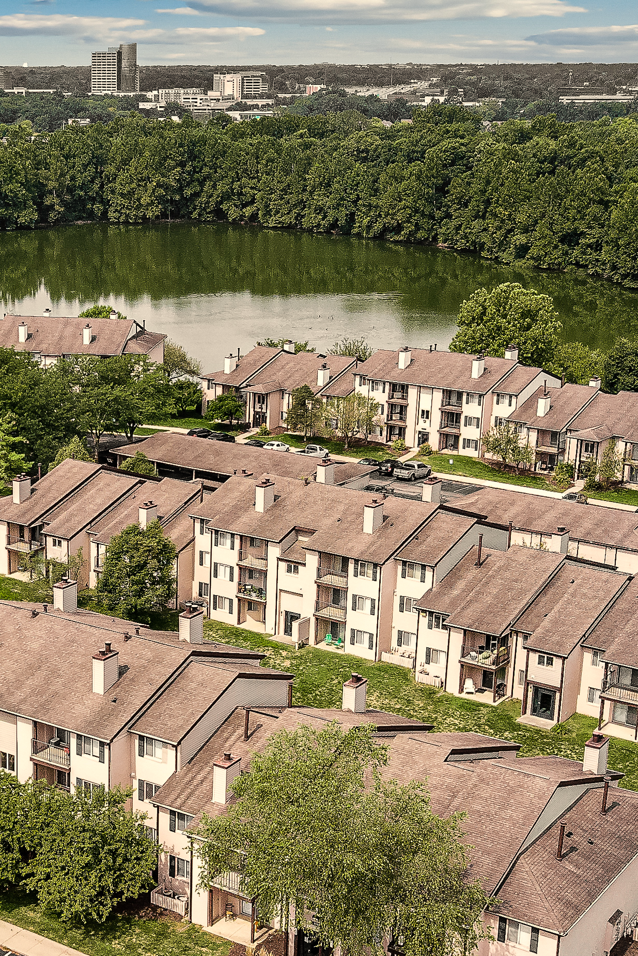
Additional Highlights
8
Undermanaged by TIC Ownership Group / Upside through Management
The Seller acquired the property in 2004 from AMLI Residential and structured the transaction as a Tenants-In-Common (TIC) ownership. Though the Property was professionally managed by the TIC sponsor, operating decisions were ultimately made by a “steering committee” of TIC owners. Members on the steering committee were not centrally located and did not have meaningful real estate experience. Operating decisions were inconsistent and were focused more on maintaining strong occupancy at the expense of organic rent growth.
In addition to the capital improvement program, Sponsor plans to implement a disciplined and detail-oriented property management program. This should help drive revenue and NOI growth while providing residents with an improved living experience.
Remarkable Submarket Fundamentals / Lack of New Supply
The Property is located within the desirable and affluent Castleton submarket of Indianapolis. Strong absorption has been further buoyed by a lack of deliveries due in part to the affluent suburb maintaining restrictions on new multifamily development. Since 2015, just three properties totaling 710 units have been delivered within a three-mile radius of the Property. With market rents exceeding $1,450 per unit, these communities have elevated the rental ceiling in the market. Most notably, there is just one property currently under construction (186 units) and no further planned development.
Strong absorption, a lack of new supply, and the desirability of the submarket due to the exceptional retail/office corridor have supported multifamily pricing power. These tailwinds have resulted in an average annual rent growth of 3.1% over the last eight years.
9

Slide 13
Additional Highlights
10
Attractive Investment Basis
Though the Property was fully marketed, Sponsor is acquiring the Property at an attractive investment basis and at a discount to recent transactions in northern Indianapolis.
Sponsor is acquiring the Property for $97,250,000, equating to $97,641 per unit and $119 PSF. Since September 2016, six comparable properties in northern Indianapolis have sold for an average of $103,000/unit and $123 PSF, with the comp set properties selling at a 5.5% premium per unit and a 3.9% premium PSF.
The recent comparable property sales demonstrate strength of the northern Indianapolis market and the attractive basis at which Sponsor is acquiring Riverbend Apartments.
11
Experienced Sponsor & Operator with Scale in Indy Market
Since 2011, the Sponsor has executed value-add improvement plans across 11,000 apartment homes with an aggregate asset value exceeding $800 million. It’s realized investments have generated a 47% gross IRR and 2.4x gross multiple on invested capital. Sponsor’s unrealized investments are projected to generate a 31% IRR and 2.5x gross multiple on invested capital.
Sponsor has deep experience in the Indianapolis MSA. Sponsor currently owns and operates 995 units in the city and has historically owned a total of 1,767 units in the city.
The Residences on 56Th Street in Indianapolis is an unrealized value-add community PPCP purchased in February of 2018 (775 units). It is located 4 miles south of Riverbend in the same submarket. The community had an average rent of $656 when purchased. After 14 months of work, approximately $21 of the $26.9 million of construction is completed. Today, average rents are $1,153. Based on the most recent appraisal, the Investment is projected to result in a 71.6% IRR and 4.62 multiple on Invested Equity.

Slide 14
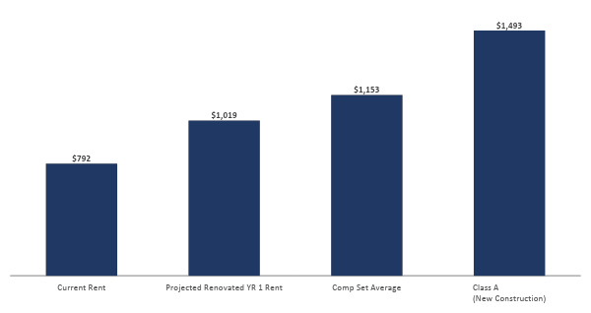
Low Cost Provider In Market
Riverbendinvestments11235.com
Several comparable communities within the Castleton submarket have undergone modest unit interior renovations, capturing weighted average rents $361 above the Property’s current in-place rents. Class A properties are achieving rental rates $701 above the Property’s current in place rents.
The substantial rent differential provides Sponsor an opportunity to execute its value-add strategy while still maintaining market rents at the low end of the comp set range. Upon completion, projected rents will be approximately $474 below that of Class A communities in the immediate submarket.
+$701
+$361
+$228

Slide 15
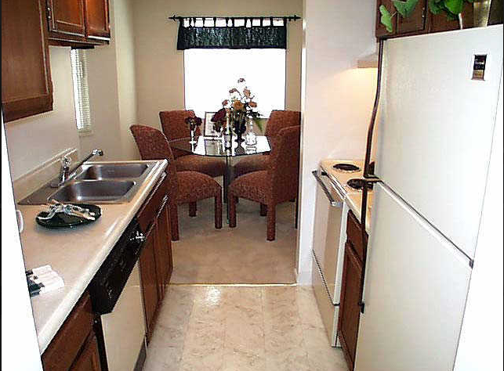
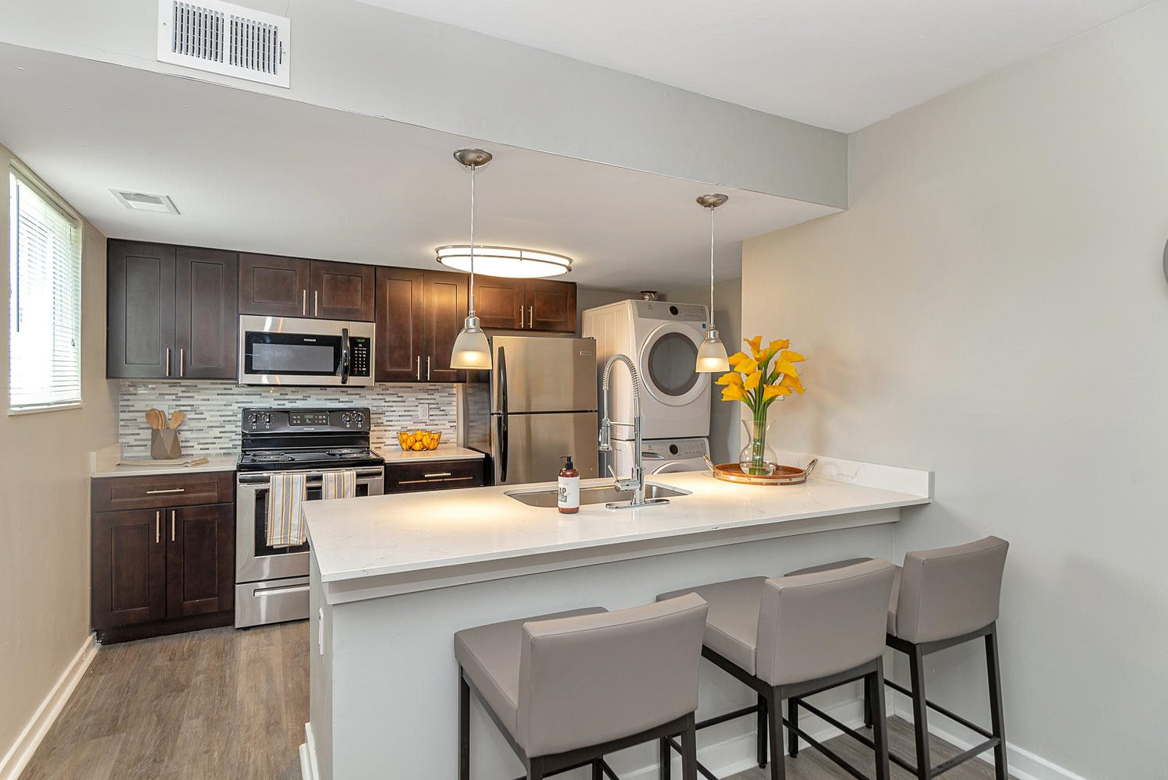
Premier Value Add Opportunity
Riverbendinvestments11235.com
Interior Renovation Cost
$13,237/unit
Exteriors, Amenities & Contingency
$5,839 /unit
Monthly Rent Premium
$228/unit
Classic Unit Interior
Proposed Renovations which Sponsor has executed at The Residences on 56th Street (Indianapolis, IN)
Given the strong demographic profile of residents in the submarket and the significant variance between current rents and those of nearby renovated and Class A apartments, Riverbend is a prime value-add candidate. Comparable properties to Riverbend are achieving premiums for upgraded units, thereby substantiating demand for high-end finishes in the area. A projected $228 weighted-average rent premium for upgraded units is forecasted at Riverbend, primarily based on rents being achieved at similar properties, and secondarily based on the large gap between Riverbend and the newer comparable set.
The Sponsor intends to dramatically improve the community through the implementation of a $19M ($19,076/unit) capital improvement program that includes interior upgrades to all 996 units and a transformational exterior/amenity enhancement program. Sponsor intends to extensively renovate and modernize the two clubhouses and pools, paint the exteriors, replace roofs throughout the entire property and update carpeting in all common area hallways.
Projected Rent Increase
28.8%

Slide 16
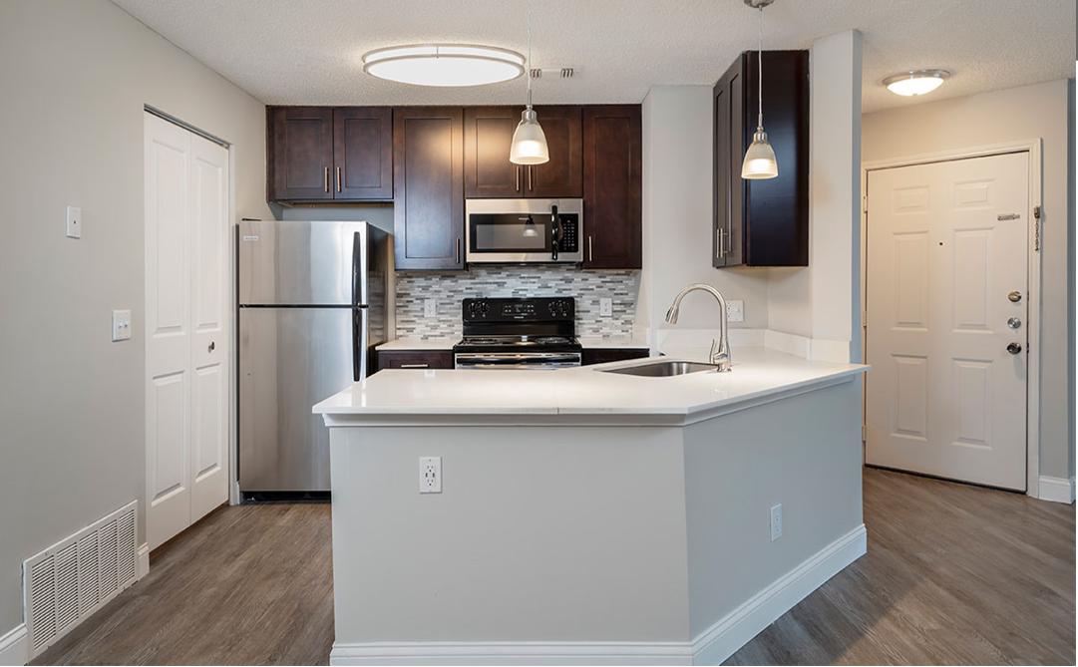
LED Light Fixtures
Two Panel Doors
Shaker-Style Wood Cabinets
Undermount Sink & Gooseneck Faucet
4 Piece Stainless Steel Appliances
Marble Backsplash
Quartz Countertop
Vinyl Plank Flooring
USB Outlets
Proposed Renovation (which Sponsor has executed at Barrington Place in Westlake, Ohio)

Slide 17
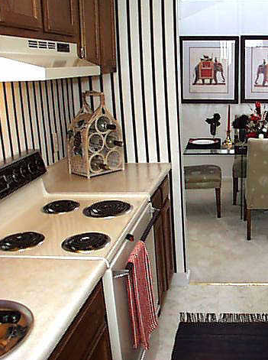
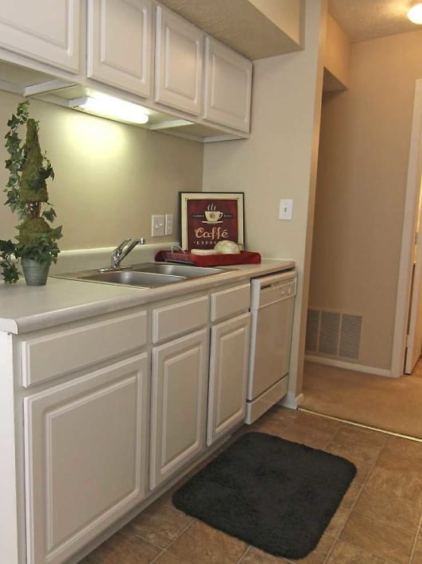
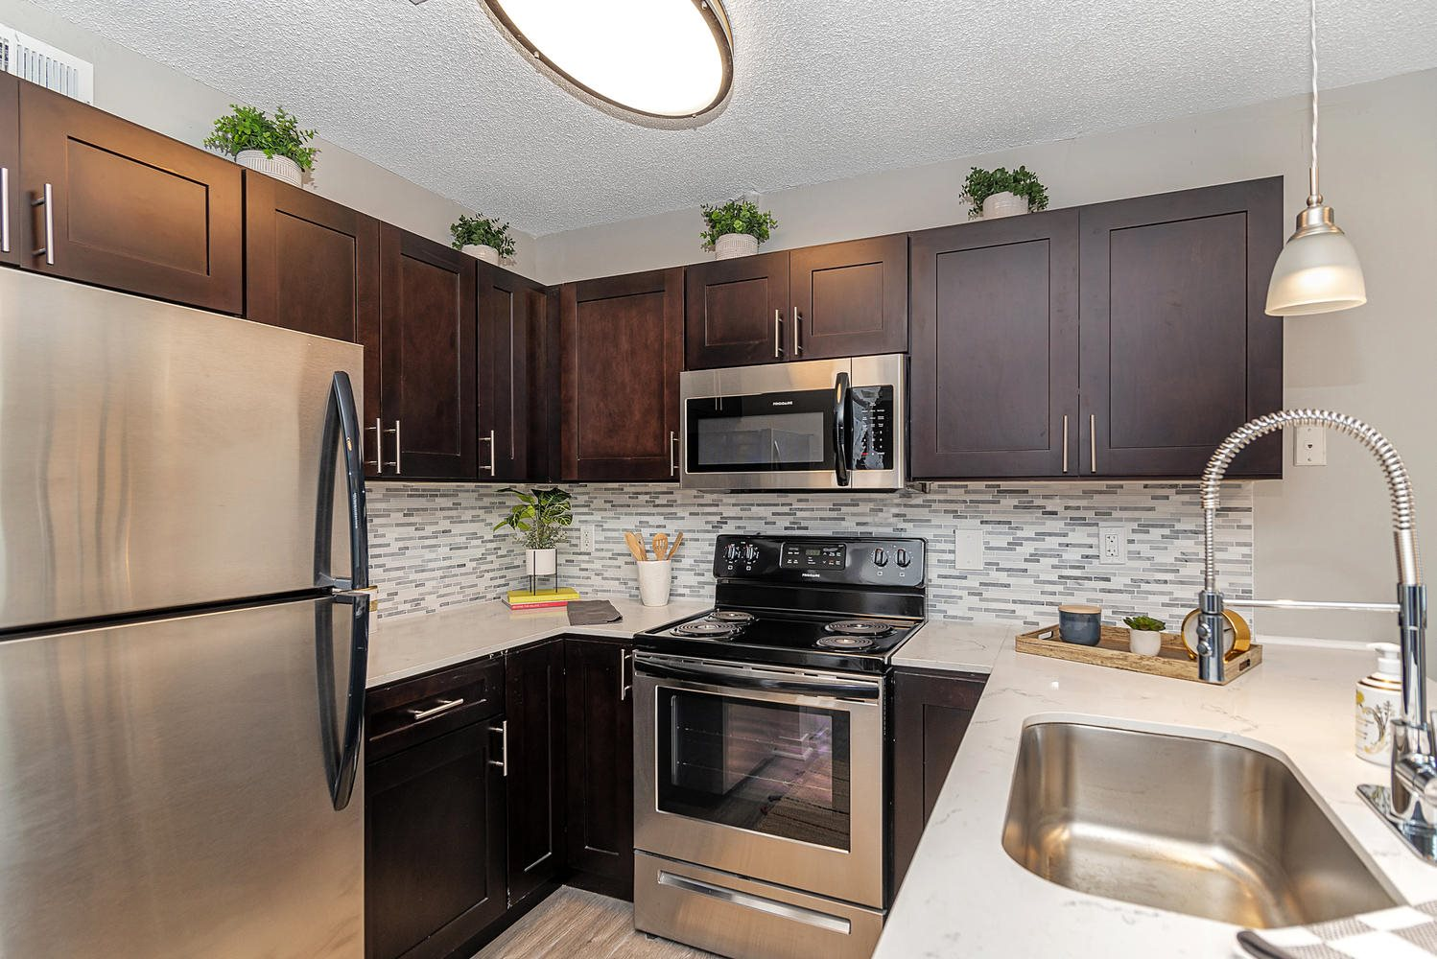
Riverbendinvestments11235.com
Renovation Detail
Classic: 300 of 996
Contemporary: 417 of 996
Luxury: 192 of 996
Elite: 87 of 996
Proposed Renovation
Average Leased Rent: $784
Average Leased Rent: $720
Average Leased Rent: $852
Average Leased Rent: $915
Projected YR 1 Rent: $1,019
Sponsor projects renovating all 996 units to a modern level of finish, which will include shaker-style cabinets/vanities, vinyl-plank flooring throughout all common living areas, granite/quartz countertops, subway tile backsplash, brushed-nickel fixtures, stainless-steel appliances and full-size washer/dryers.
As shown in the photos above, the Property currently offers four levels of finish. Classic units (30% of units) are original to the community. Contemporary (42%) and Luxury (19%) units were renovated 13+ years ago by a prior owner. Lastly, in 2017, the current owner renovated 87 units to an “Elite” level of finish, which included Formica countertops, stainless steel appliances and faux wood plank flooring. The Elite units are being leased at a $131 to $195 per month premium to the classic and contemporary units.
The Classic units and those completed 13+ years ago do not meet the demands of prospective residents in the Castleton submarket. As a result, Sponsor intends to renovate 100% of the units to a high level of finish, which includes the furnishing of washers and dryers in the apartment homes.

Slide 18
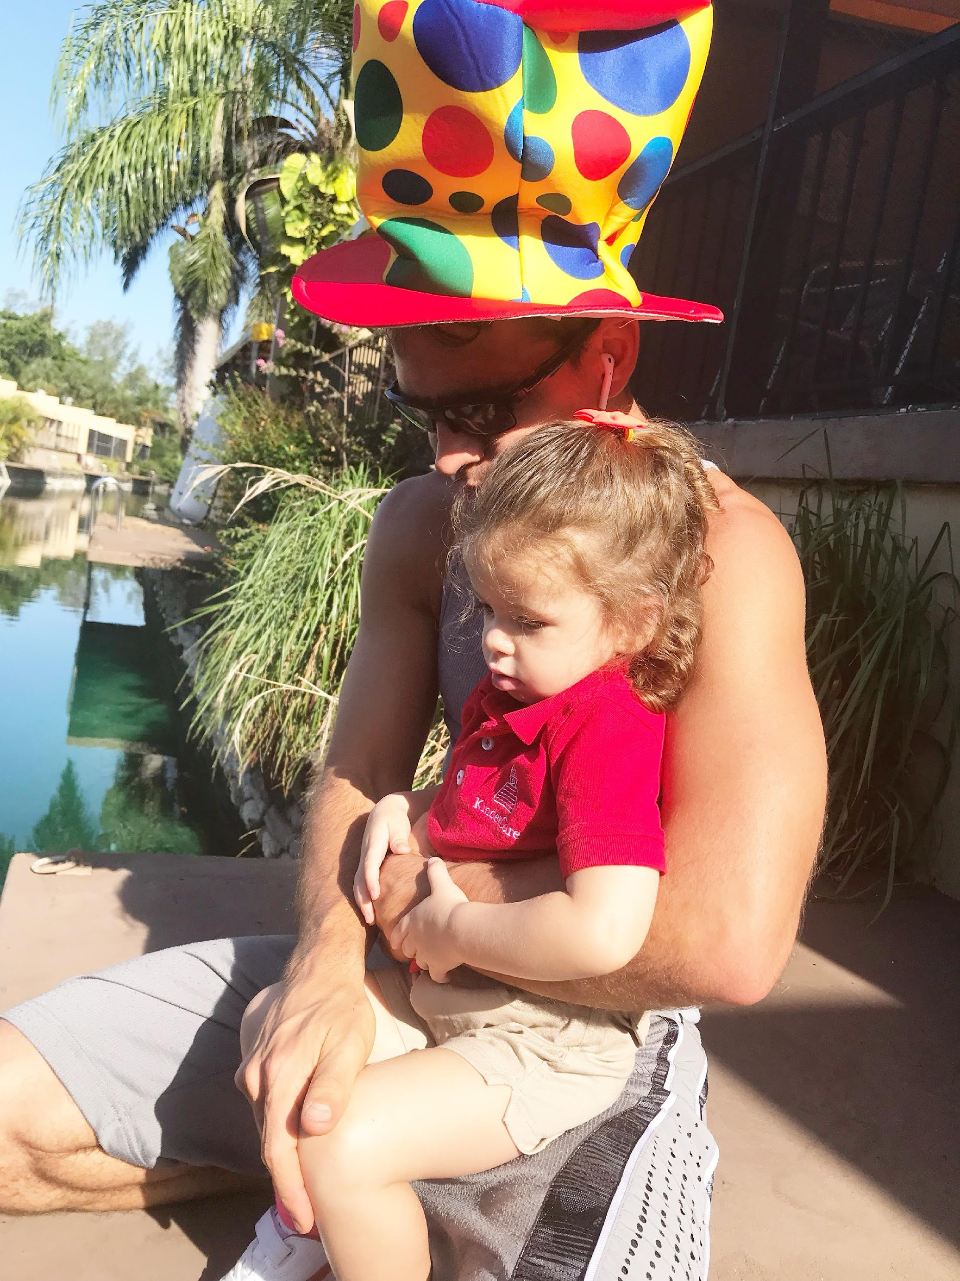
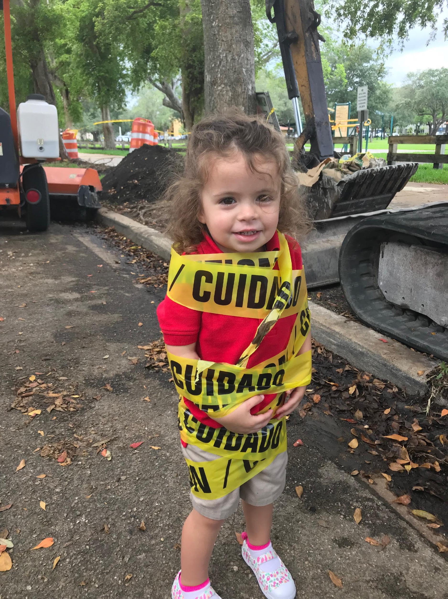
About Us- Ramon Gonzalez
Married, one 4 year old angel and a Queen and 1 in the Oven
CEO of SHB LLC
Manager of SHB Investments Portfolio
Started buy and hold in CT (sold mostly 05/06)
Wholesaled and Fix and Flip over 250 properties in Fl
Rebuilt rental portfolio and sold in Miami 89 doors
Real Estate Investor since 2005
Made it through the last cycle successfully
In 2017 shifted from active RE Entrepreneur to Passive RE Investor
Specialty:
Short-term Bridge / Hard Money Funding/GAP funding
Joint ventures
Invest equity on predictable cash-flow, and value-add driven appreciation
e.g. Self-Storage, Multifamily
Personal:
Loving Husband and Dad
Philanthropist & Lifestyle Entrepreneur + Podcaster
Physical Fitness- Basketball, Volleyball, Weightlifting

Slide 19
Riverbendinvestments11235.com
About Us- Mike Zlotnik
CEO and Principal of TF MANAGEMENT GROUP, LLC: 2014 - TF Investment Fund II LLC 2017 - Tempo Opportunity Fund LLC 2020 - Tempo Growth Fund LLC
Mike Zlotnik has been a debt and equity investor in real estate for since 2000. He started his career and has spent nearly 15 years in the information technology field managing Risk, Business Intelligence and Quality of complex systems, software and processes. While building a successful career in IT, Mike’s passion has always been real estate investing because of its predictability of outcome and well understood risks.
In 2009, Mike joined Tempo Funding, LLC (Mortgage Pool Fund) as a managing partner, and Vice President of funding operations. Starting from January 2014, Mike has assumed the responsibility of a CEO and has since founded TF Management Group, LLC, launching 3 new real estate investment funds, TF Investment Fund II LLC (Income Fund), Tempo Opportunity Fund LLC (Growth & Income Fund) and Tempo Growth Fund LLC (Growth Fund). Under Mike’s Leadership, the company has seen transformation & growth, delivering strong returns for the fund investors.
Mike holds a Bachelor’s degree in Mathematics from Binghamton University. Mike is a member of multiple real estate and investor mastermind groups such as Collective Genius, Freedom Founders, Venture Alliance, CA Investors (Private).

Slide 20
Sponsor Overview
PEPPER PIKE
CAPITAL PARTNERS
Pepper Pike Capital Partners is a real estate investment, redevelopment and management company based in Cleveland, Ohio. The team is comprised of a diverse group of entrepreneurial real estate professionals. Over the past decade, its principals have acquired and redeveloped over 27,000 apartment units throughout the Midwest and Southeast, with a cumulative transactional value in excess of $1.75 billion.
The company acquires, renovates, and manages multifamily real estate on behalf of private investors, family offices and institutional equity partners. As stewards of their partners’ capital, the company invests with a clear focus on strong cash-flow, value creation and, most importantly, the preservation of value. Pepper Pike employs a value-add investment strategy, typically achieved through significant improvements to unit interiors and community amenities, but also through a focus on efficient property management.
Paul Kiebler is the Founder and Chief Executive Officer of Pepper Pike Capital Partners. As CEO, Paul directly oversees the firm’s strategic initiatives and its investment professionals, including the acquisitions, operations and construction management groups. Since 1998, Paul has been directly involved in the planning, construction, lease up and management of all Pepper Pike transactions.
MIDWEST ROOTS. EXPANSIVE FOOTPRINT.
Pepper Pike Capital Partners and related entities have historically owned over 27,000 units across 8 states and 13 cities. Pepper Pike’s current portfolio includes a diverse mix of Class B properties throughout high-yielding markets in Ohio, Michigan, Indiana and Illinois.

Slide 21
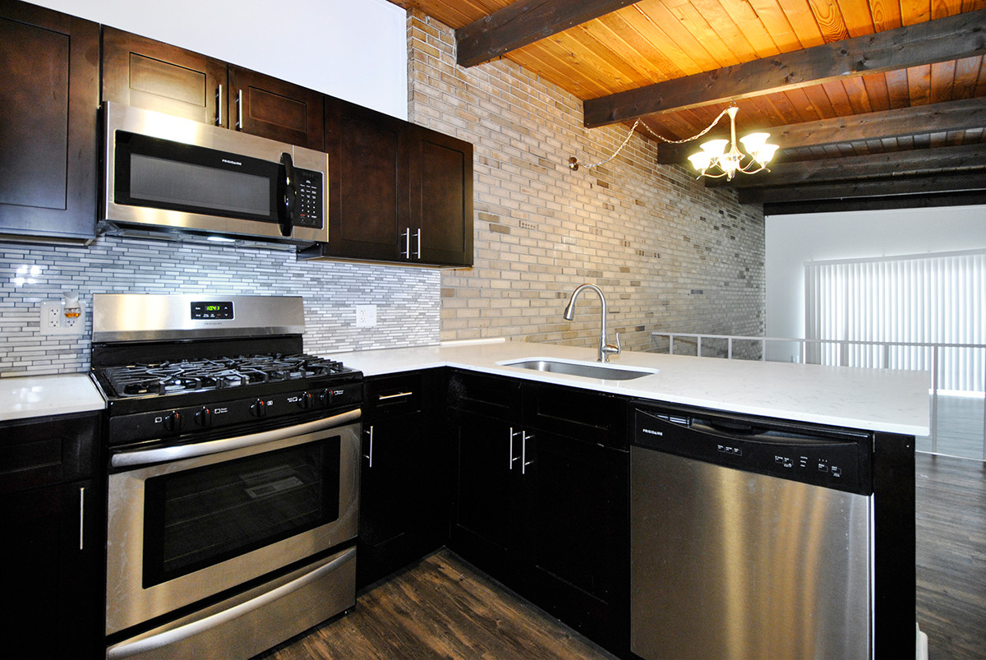
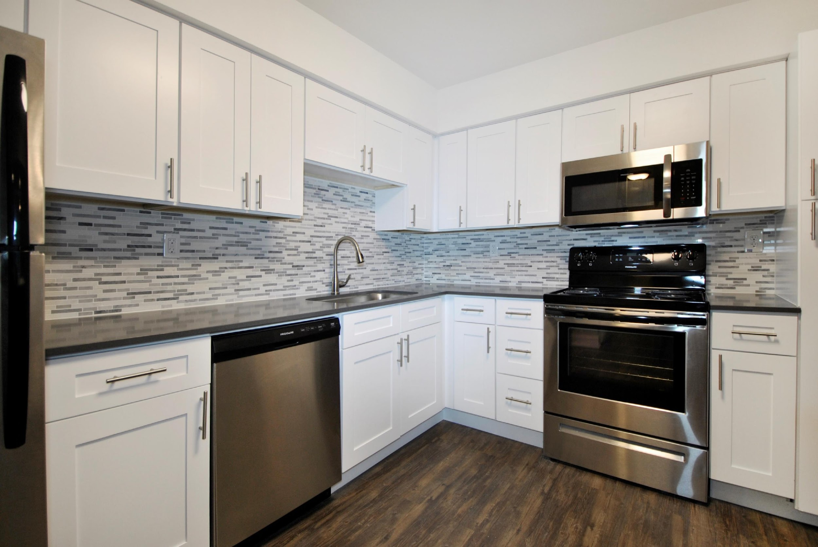
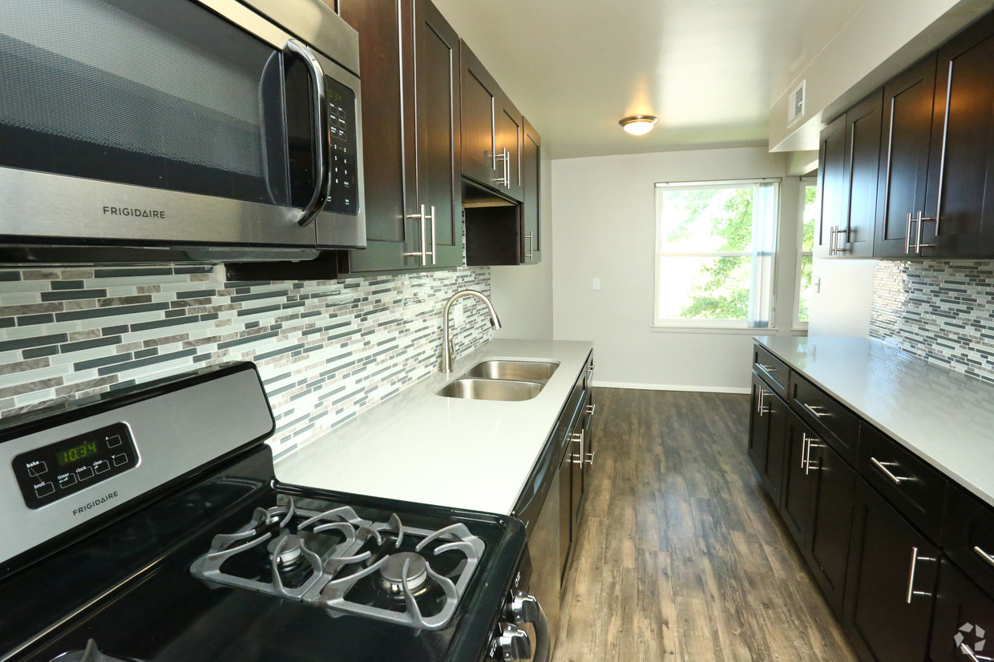
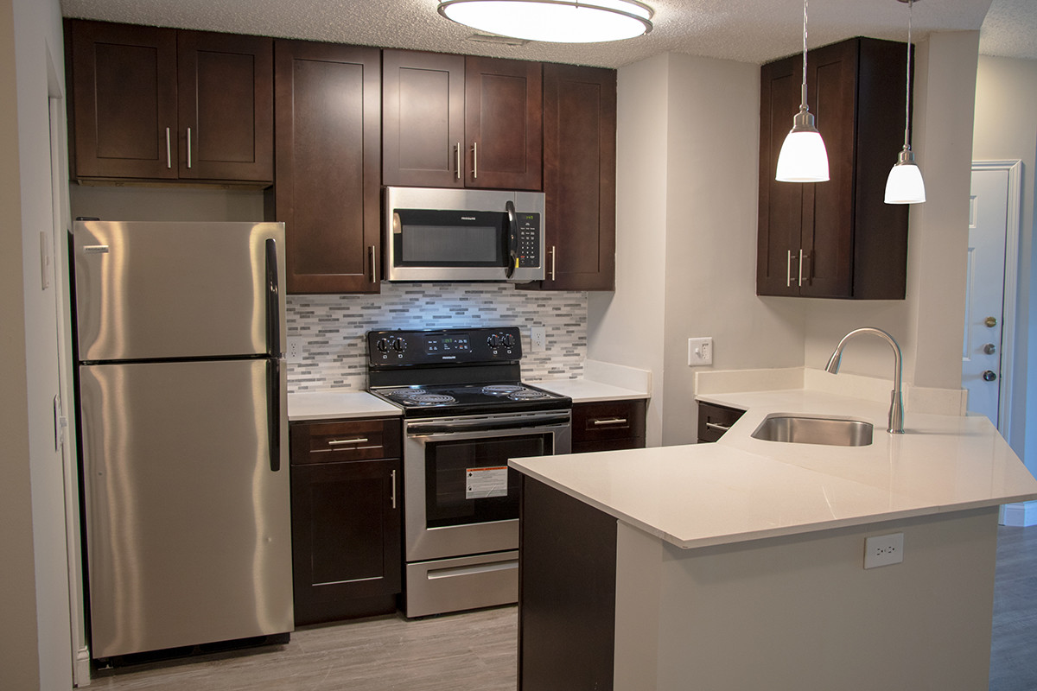
Sponsor Track Record
Riverbendinvestments11235.com
The Crossings at Canton
Canton, MI
744 Units
Unit Interior Cost: $14,000
Renovated Rent Increase
$427 / 51%
(u/w @ $266 / 31%)
Retreat at Farmington Hills
Farmington Hills, MI
424 Units
Unit Interior Cost: $15,000
Renovated Rent Increase
$502 / 55%
(u/w @ $244 / 25%)
Spice Tree Apartments
Ann Arbor, MI
551 Units
Unit Interior Cost: $9,000/unit
Renovated Rent Increase
$342 / 46%
(u/w @ $188 / 25%)
Barrington Place
Westlake, OH
164 Units
Unit Interior Cost: $13,000/unit
Renovated Rent Increase
$281 / 29%
(u/w @ $222 / 23%)
Residences on 56th Street
Indianapolis, IN
755 Units
Unit Interior Cost: $18,400/unit
Renovated Rent Increase
$382 / 58%
(u/w @ $203 / 31%)
Sponsor has successfully executed its value-add renovation program across ~5,000 apartment homes in the Midwest since 2017. It’s five most recent transactions have realized monthly rent increases of $281 to $502 per unit, or 29% to 58% above in-place rents at time of acquisition.
The realized monthly rent increases were an average of 72% higher ($387/month) than the underwritten projections ($225/month) at the time of their acquisition.

Slide 22
Riverbendinvestments11235.com
Contact Us
For more information, please contact:
Mike Zlotnik Ramon Gonzalez mike@tempofunding.com ramon.gonzalez@summithb.com
(917) 806-5029 (305) 965-9923
BigMikeCall.com

